Slide 1

Exploratory Data Analysis
G2M Insight Cab Investment Firm
21-07-2023

Slide 2

Agenda
Executive Summary
Problem Statement
Approach
EDA
EDA Summary
Recommendations

Slide 3
Background : G2M Cab Industry
XYZ is private firm in US
Due to remarkable growth in Cab Industry, in last few years and multiple key players in market , they are planning to invest in Cab industry
As per their Go-to-Market (G2M) Strategy , they want to understand market before taking final decision.
Business Problem
Identify right company to make investment using actionable insights

Slide 4
Analysis
Our analysis can be divided into four parts
Understanding the data
Exploring the data
Identify the most profitable company
Recommendations

Slide 5
Understanding the data
Dataset
Time period of data is from 31-01-2018 to 31-12-2018.
No missing values in any of the datasets
No duplicate rows in any of the datasets.
Outlier Detection
Method:IQR (Interquartile Range)
There are some outliers in the 'Price Charged' column
These transactions have unusually high charges, which could be due to long-distance trips, surge pricing, or other factors
Cab_Data.csv
Customer_ID.csv
Master Data
Transaction_ID.csv
City.csv

Slide 6
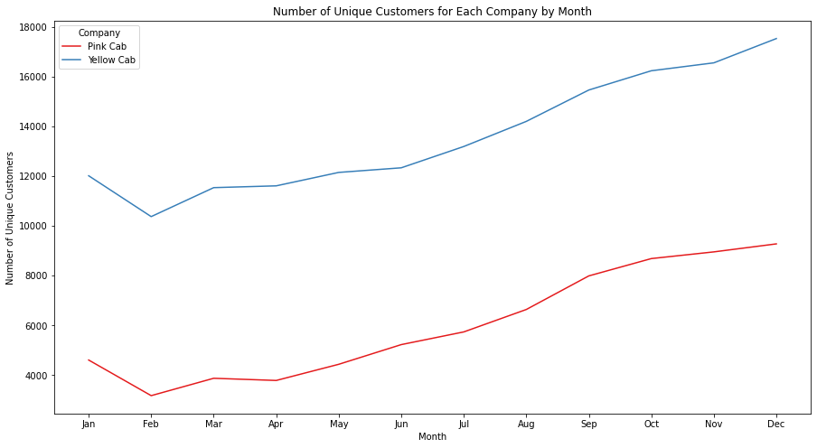
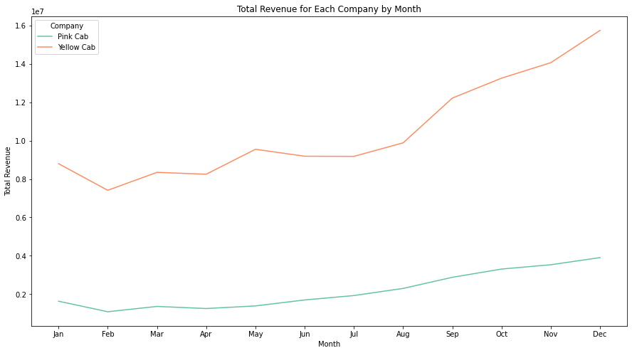
Seasonal Analysis
The seasonal analysis reveals similar patterns for both cab companies, with peaks in customer numbers and revenue during the winter months (especially December and January), and troughs during the summer months

Slide 7
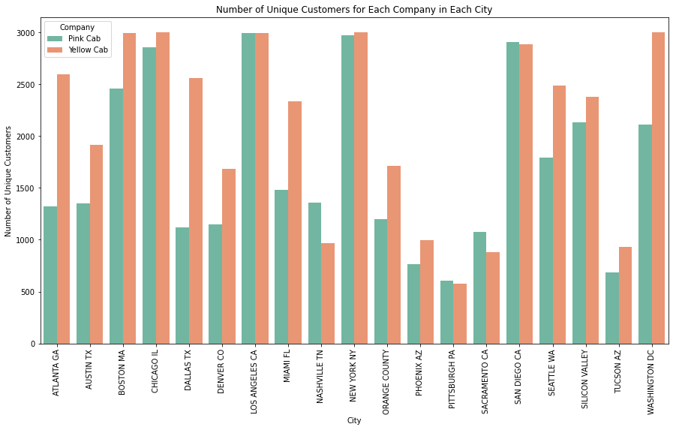
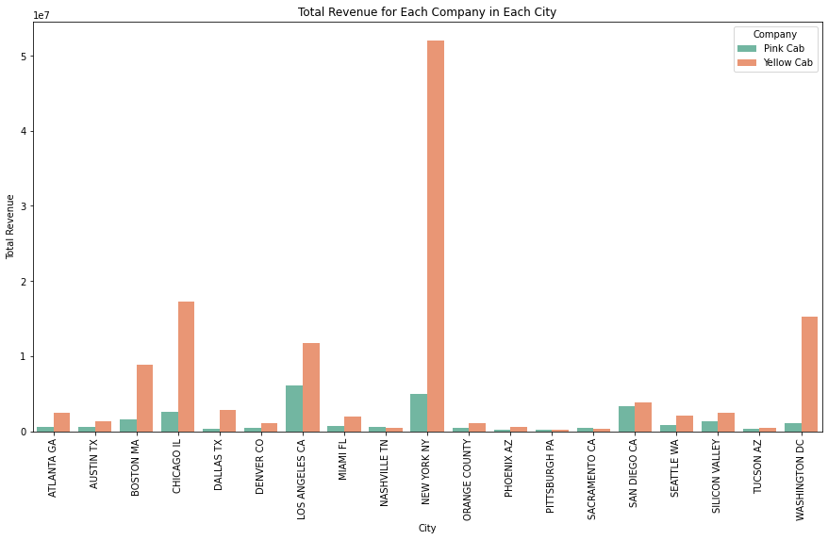
Analysis by City
Yellow Cab has a higher number of unique customers in almost all cities compared to Pink Cab.
Yellow Cab also generates higher revenue in most cities compared to Pink Cab
Overall analysis shows that Yellow Cab has a larger market share and higher revenue compared to Pink Cab

Slide 8
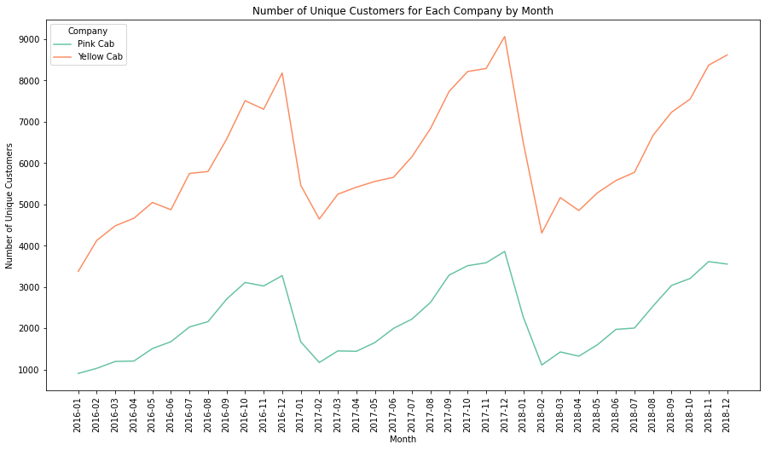
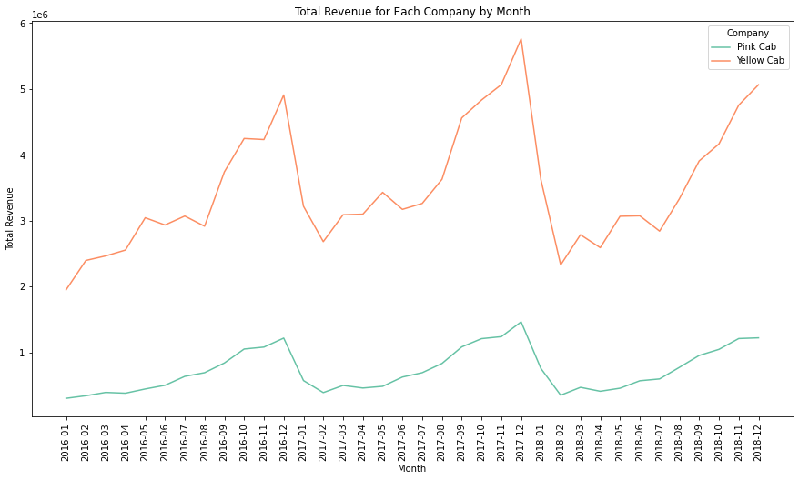
Temporal Analysis
From the first chart(left), we can see that the number of unique customers for both companies shows some seasonality, with peaks around the beginning and end of each year. The number of customers for Yellow Cab is consistently higher than for Pink Cab throughout the period.
From the second chart, we can see that the total revenue for both companies also shows some seasonality, with peaks around the beginning and end of each year. The revenue for Yellow Cab is consistently higher than for Pink Cab throughout the period. We can also see that the revenue for Yellow Cab is growing over time, while the revenue for Pink Cab is relatively stable.

Slide 9
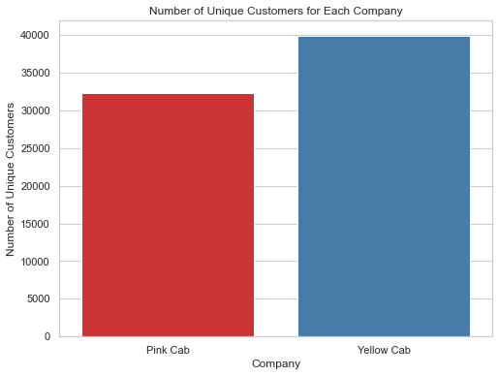
Which company has more cab users?
Yellow Cab company has 39,896 unique customers, while the Pink Cab company has 32,330 unique customers
Yellow Cab company has more unique users than the Pink Cab company

Slide 10
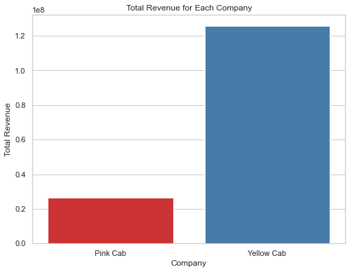
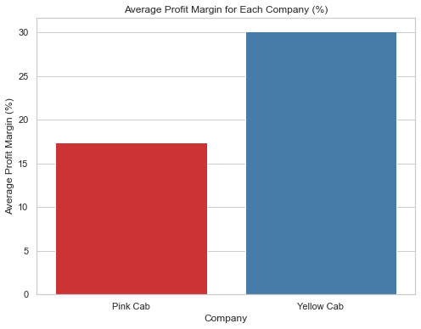
Profit based on High Margins and Revenue

Slide 11
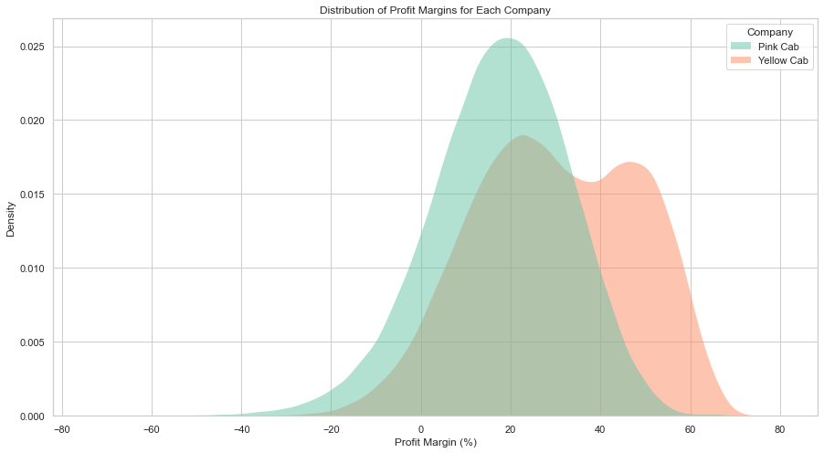
Profitability Analysis
It shows that the profit margins for Yellow Cab tend to be higher than for Pink Cab. Moreover, the profit margins for Yellow Cab show a wider distribution, indicating more variability in their profitability.

Slide 12
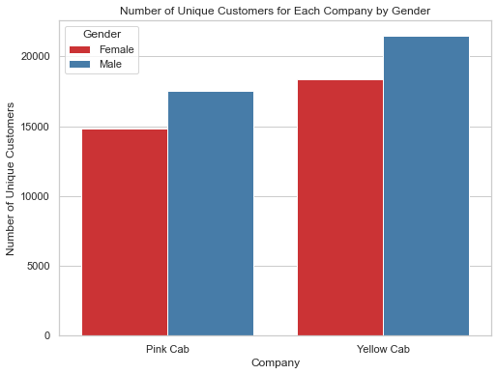
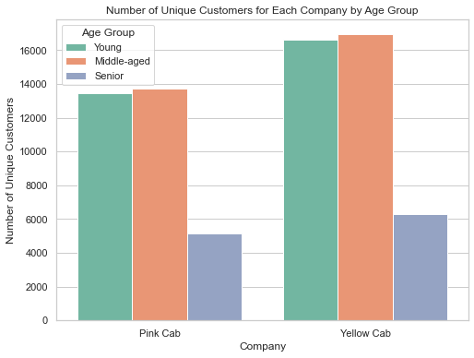
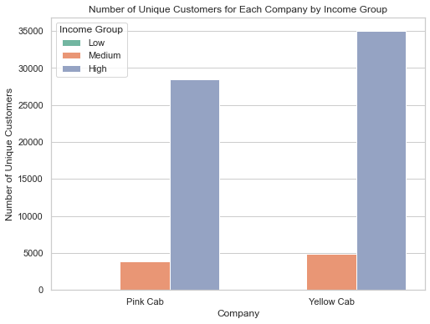
Customer segments based on gender, age and income
The number of male customers is higher than the number of female customers. However, the difference in numbers between male and female customers is more in Yellow Cab compared to Pink Cab.
The largest group of customers for both companies is the middle-aged group (30-50), followed by the young group (18-30), and then the senior group (50+). This trend is similar for both companies.
The largest group of customers for both companies falls in the 'High' income group (5000+), followed by the 'Medium' income group (2000-5000), and then the 'Low' income group (0-2000). This trend is similar for both companies.

Slide 13
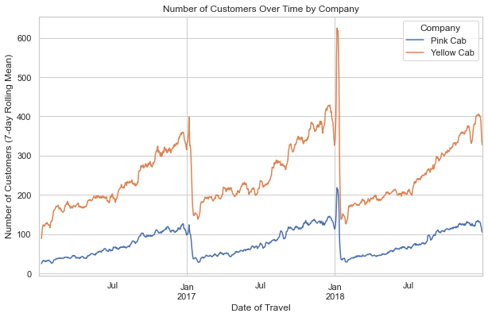
Which company has more customers during particular time?
The plot shows the number of customers over time for each company, with a 7-day rolling average applied to smooth out daily fluctuations. We can observe that Yellow Cab consistently has a higher number of customers than Pink Cab over the considered time period.

Slide 14
Recommendations
The seasonal analysis reveals similar patterns for both cab companies.
Yellow Cab has a higher number of unique customers in almost all cities compared to Pink Cab.
Yellow Cab generates higher revenue in most cities compared to Pink Cab.
The number of customers and revenue for Yellow Cab is growing over time, while for Pink Cab it is relatively stable.
The profit margins for Yellow Cab tend to be higher and more variable than for Pink Cab.
The Yellow Cab company has a larger customer base, higher total revenue, and higher average profit margin compared to the Pink Cab company
The distribution of customers based on gender, age, and income is similar for both companies
Based on data analysis, the Yellow Cab company appears to be a better investment option.

Slide 15
Thank You

